Slide 1
COURSE CONTENT SIMPLIFICATION AGENT
CAPSTONE PROJECT
Presented By:-
Saarth Hakim J.C Bose University of Science and Technology, YMCA
Computer Engineering Department

Slide 2
OUTLINE
Problem Statement
Proposed System/Solution
System Development Approach
Steps of Deployment
Result
Conclusion
Future Scope
References

Slide 3
Problem Statement
Problem Statement No.19 – Course Content Simplification Agent
The Challenge – Educational materials often vary in complexity and are not always accessible to learners with different levels of prior knowledge. Students may struggle to grasp key concepts due to jargon heavy or overly advanced explanations in faculty notes and textbooks. The challenge is to develop an AI powered agent that can intelligently analyze academic content and reframe explanations based on the learner's current proficiency—ranging from beginner to expert. This would support more inclusive learning and personalized education delivery at scale.

Slide 4
Proposed Solution
To tackle the challenge of making educational content accessible to learners at different comprehension levels, we propose a Course Content Simplification Agent — a web-based tool that uses AI to simplify text based on user-selected difficulty levels (e.g., beginner, intermediate, advanced).
The core of this solution is an AI Agent developed using the Mistral Large language model, deployed via IBM Watsonx services on the IBM Cloud Lite plan. This AI agent processes input content and generates a simplified version tailored to the selected level.
The application consists of:
A Frontend Interface for content input and level selection.
A Python Flask Backend that connects to the AI agent via IBM Cloud.
The AI Simplification Logic, powered by the Mistral Large model, ensuring contextually accurate and readable output.
Key features include:
Real-Time Simplification with adaptive difficulty.
Cloud-Based AI Integration ensuring scalability and reliability.
Enhanced Accessibility for learners at all levels.
This solution enables personalized learning, helping students better grasp complex course materials through AI-driven content adaptation.
GitHub Repo link - https://github.com/Srthhkm/Course-Content-Simplifier-Agent

Slide 5
System Approach
SYSTEM REQUIREMENTS
Hardware Requirements:
Processor: Intel i5 or higher
RAM: 8 GB minimum
Storage: 500 MB free disk space
Internet Connection: Required for IBM Cloud API access
Software Requirements:
Frontend: HTML5, CSS3, JavaScript
Backend: Python 3.x - Flask Framework
Cloud Platform: - IBM Cloud Lite Account
- IBM Watsonx Assistant
AI Model: Mistral Large Language Model (deployed via IBM Watson)

Slide 6
STEPS OF Deployment
1. Develop the Web Application
Create the frontend using HTML, CSS, and JavaScript for user interaction (content input and level selection).
Build the backend using Python Flask to process user requests and communicate with the AI model.
2. Set Up IBM Watsonx on IBM Cloud
Register for an IBM Cloud Lite account.
Deploy the Mistral Large language model using IBM Watsonx services.
Generate and obtain API credentials (API key, IAM token, endpoint URL).
3. Integrate Backend with AI Agent
Connect the Flask backend to IBM Watsonx using REST API calls.
Structure input prompts with user content and selected difficulty level.
Send requests to the AI model and handle the simplified content response.
4. Local Testing
Run the Flask server locally and test all functionalities.
Verify accurate AI responses and smooth frontend-backend integration.
5. Documentation and Demonstration
Prepare documentation and screenshots of the working system.
Use Github repository for submission - https://github.com/Srthhkm/Course-Content-Simplifier-Agent

Slide 7
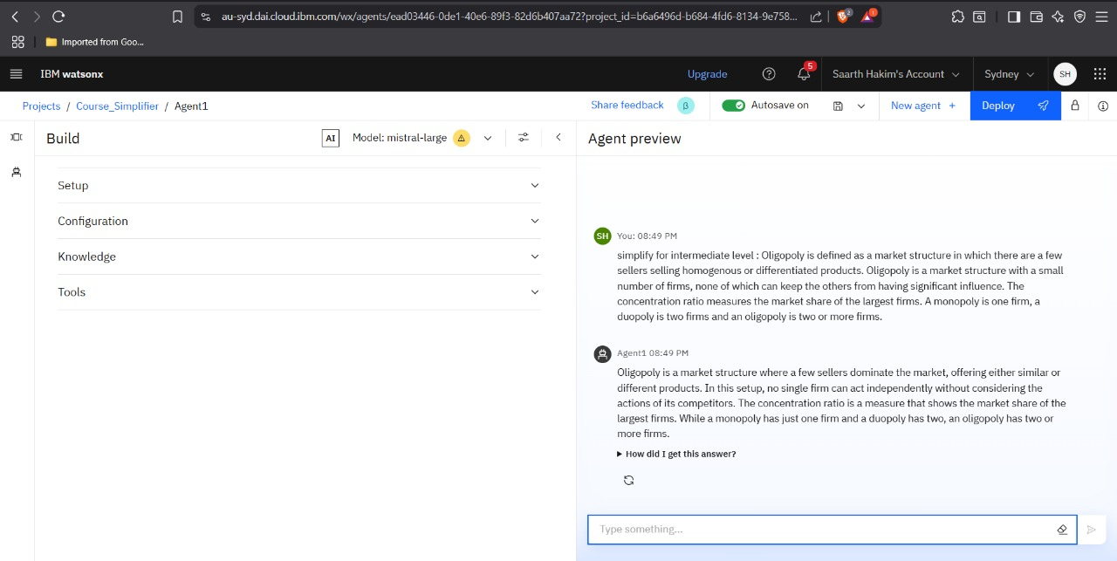
Result
AI Agent interface showing response based on Intermediate level

Slide 8
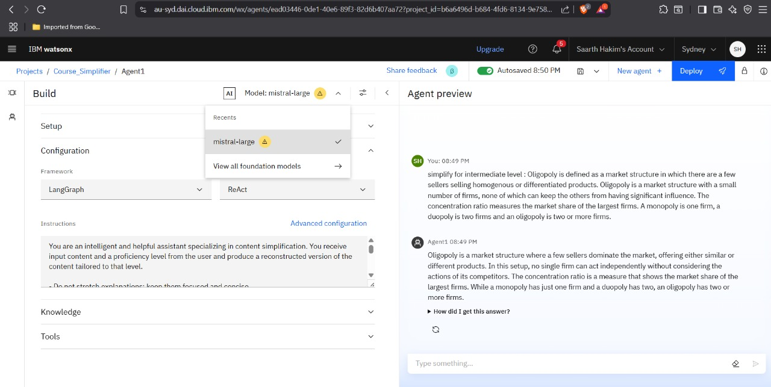
Result
Model and Configuration of AI Agent

Slide 9
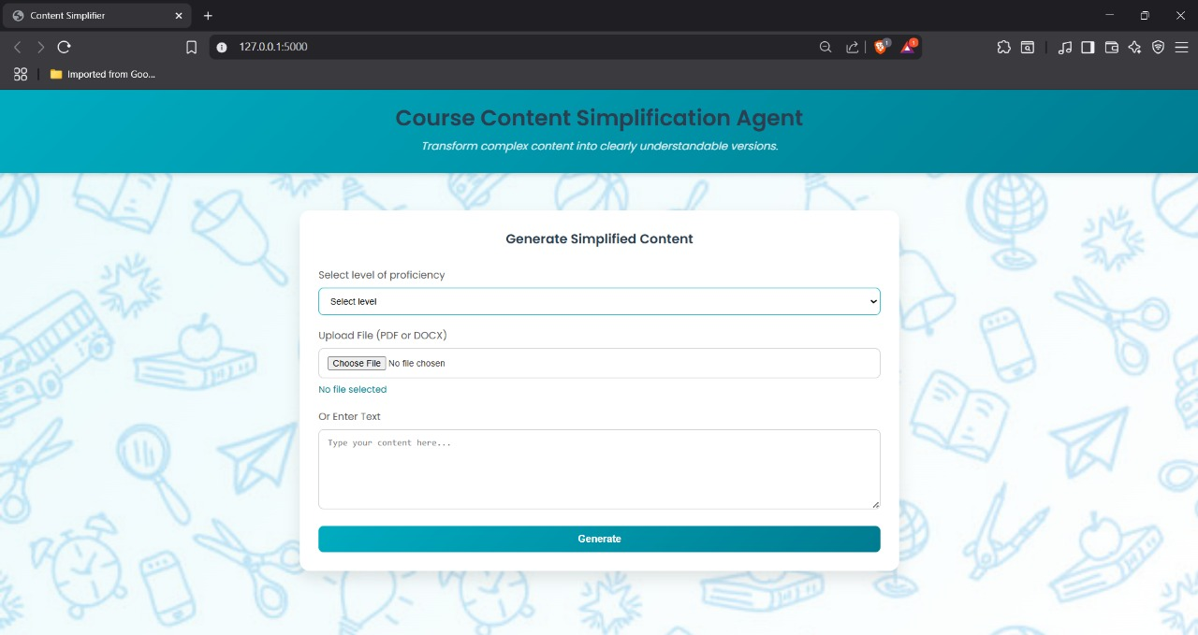
Result
Frontend - UI of project application

Slide 10
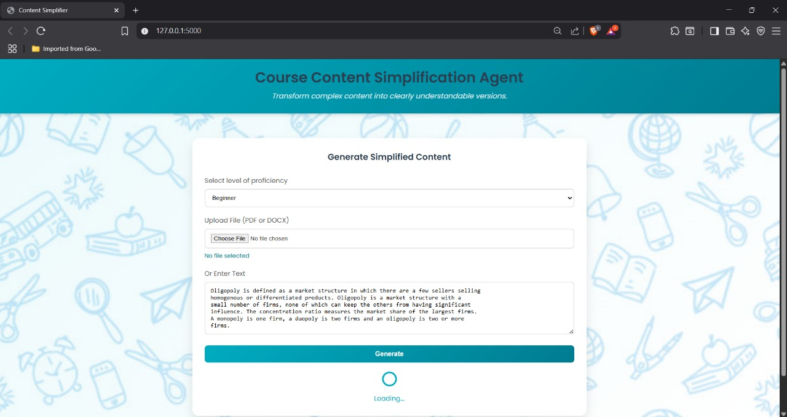
Result
Example 1 : Text Input - Beginner level

Slide 11
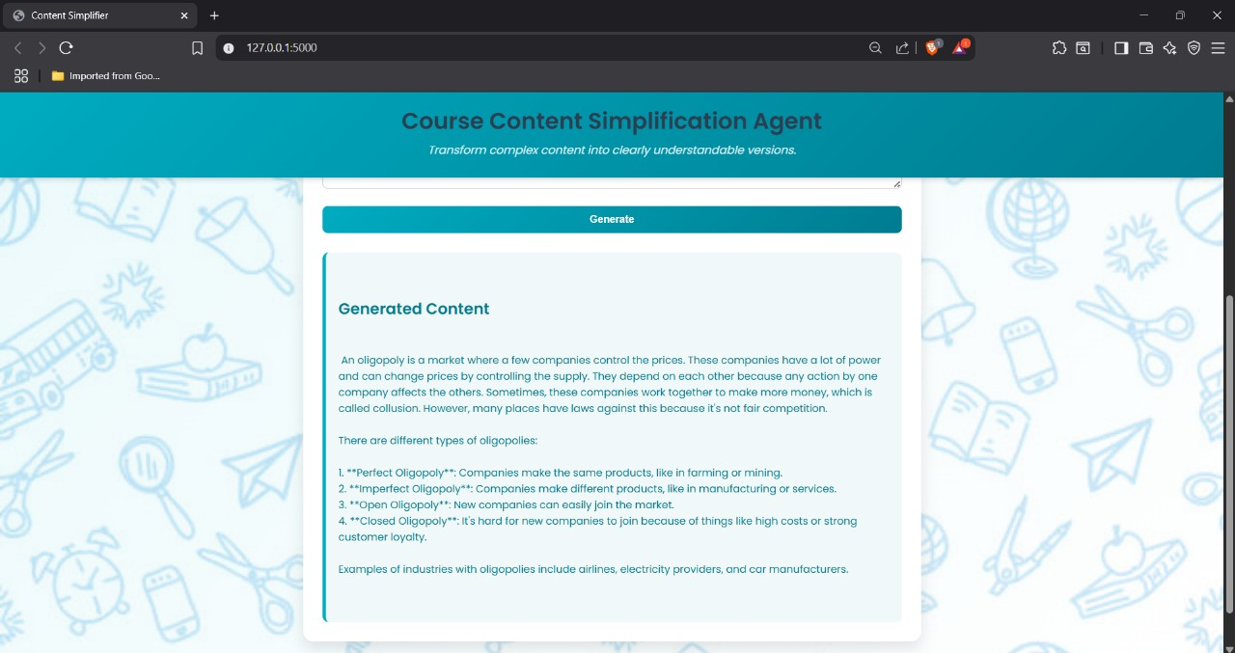
Result
Example 1 : Generated Output - Beginner level

Slide 12
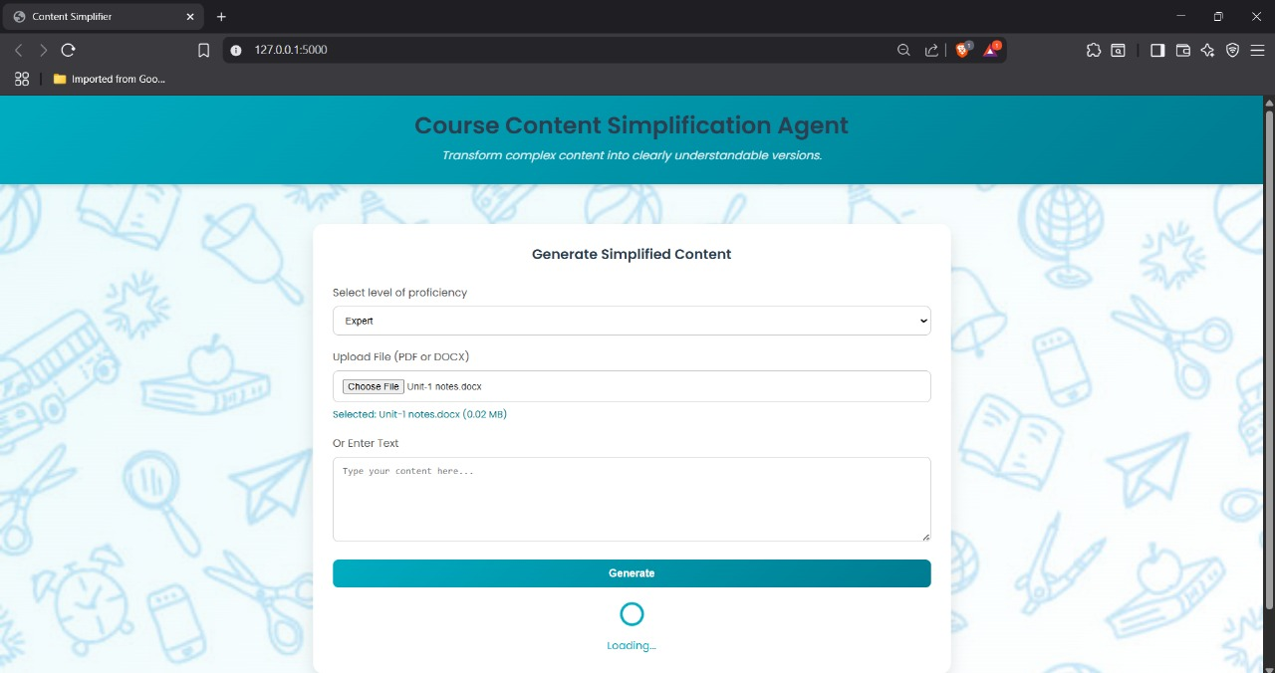
Result
Example 2 : File Input - Expert Level

Slide 13
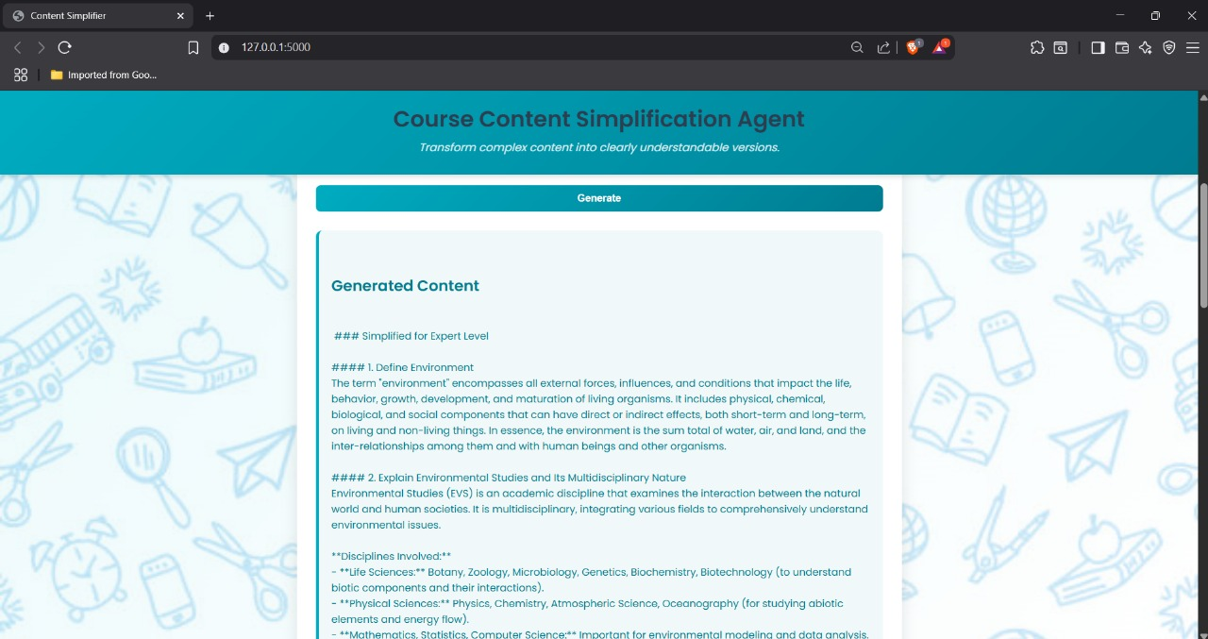
Result
Example 2 : Generated output - Expert level

Slide 14
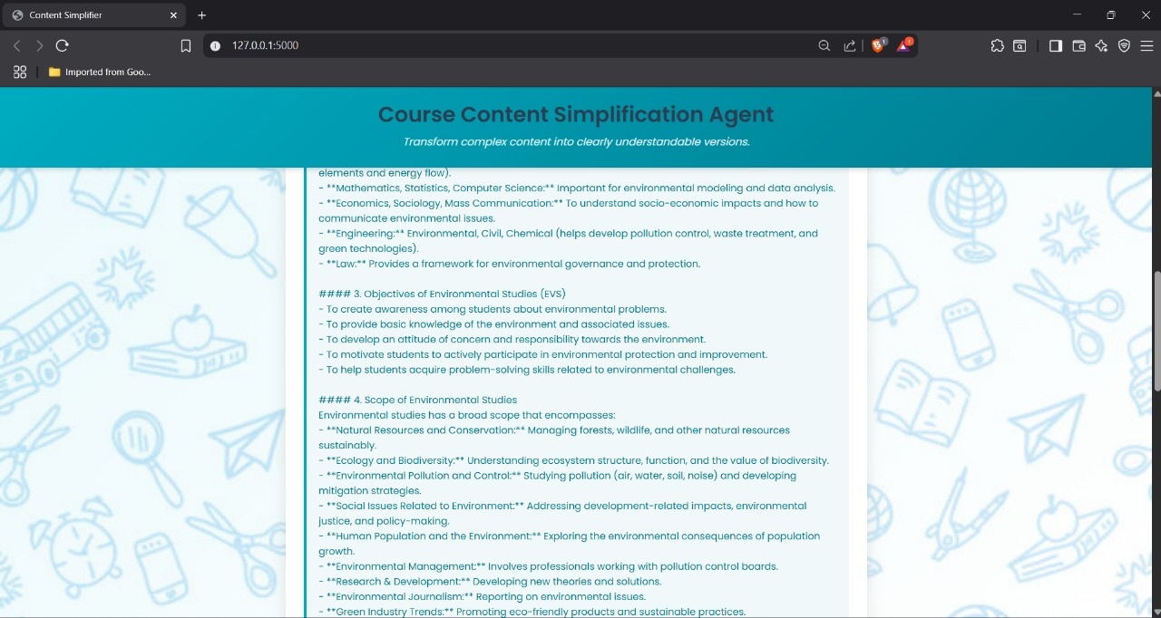
Result
Example 2 : Generated output - Expert level

Slide 15
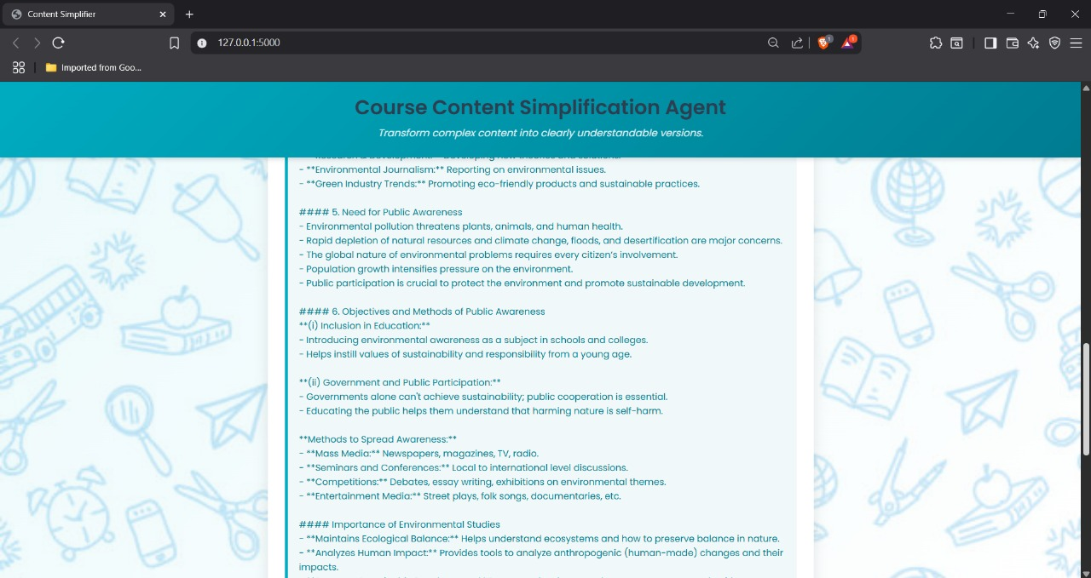
Result
Example 2 : Generated output - Expert level

Slide 16
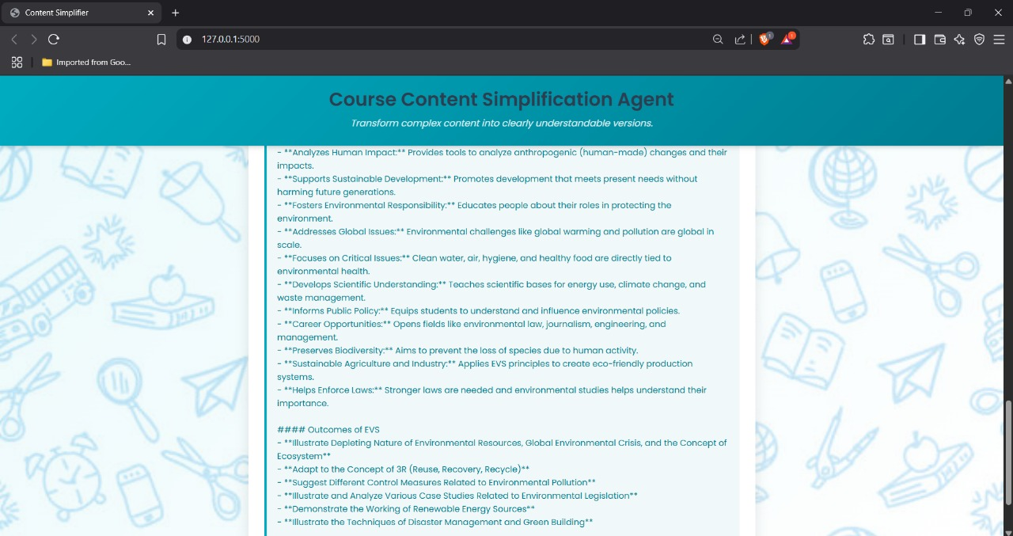
Result
Example 2 : Generated output - Expert level

Slide 17
Conclusion
The Course Content Simplification Agent effectively simplifies complex educational material into user-friendly versions suited for various proficiency levels (Beginner, Intermediate, Expert). It utilizes the Mistral Large language model via IBM Watsonx, integrated into a web-based platform built with Python Flask.
Effectiveness of the Proposed Solution:
Delivers accurate, real-time simplification while preserving the original meaning.
Enhances accessibility for diverse learners by adapting content complexity.
Provides a seamless and intuitive user experience through a clean web interface.
Challenges Encountered:
API integration required careful handling of authentication and rate limits.
Managing large file inputs necessitated robust file validation and error handling.
Fine-tuning prompt structure was essential to ensure high-quality simplification output.
Potential Improvements:
Support for additional input types such as audio and multi-language content.
Advanced customization options for tone, length, and style of simplified content.
Integration of feedback mechanisms for continuous improvement of AI responses.
Importance of Content Simplification: Content simplification is essential in making educational materials more inclusive and easier to understand. It supports learners with varying comprehension levels, promotes better engagement, and helps bridge knowledge gaps, ultimately improving the overall learning experience and outcomes.

Slide 18
Future scope
The Course Content Simplification Agent can be further improved and expanded to increase its functionality, reach, and performance. Potential enhancements include:
1. Multi-Language Support
Enable the AI to simplify content in multiple languages, making the tool accessible to a wider audience globally.
Integrate translation APIs or multilingual AI models for cross-language content adaptation.
2. Additional Input Formats
Support for scanned PDFs, images (using OCR), and speech input (voice-to-text).
Allow bulk processing of files for institutions and educators.
3. Improved AI Model Customization
Fine-tune the AI for specific subjects (e.g., science, history) to improve context-aware simplification.
Add user options for tone, content length, or focus (e.g., summarization vs. simplification).
4. Integration with Learning Platforms
Embed the system into Learning Management Systems (LMS) like Moodle or Google Classroom.
Allow direct content import/export between platforms and the agent.
5. Scalability and Cloud Deployment
Scale the system for institutional use (e.g., schools, universities).
Deploy on scalable cloud infrastructure with load balancing and multi-user support.

Slide 19
References
1. Mistral AI – Mistral Large Model Overview : Mistral AI. (2024). Mistral Large: Efficient, high-performance language model. Retrieved from: https://www.mistral.ai/models/
2. IBM Watsonx Documentation : IBM Cloud. (2024). Getting Started with Watsonx and Foundation Models on IBM Cloud. Retrieved from: https://cloud.ibm.com/docs/watsonx
3. Text Simplification with Pre-trained Language Models - Qiang, J., Li, Y., Zhu, Y., & Yuan, Y. (2022). A Survey of Text Simplification: Approaches, Datasets, Evaluation, and Challenges. ACM Transactions on Intelligent Systems and Technology, 13(4). DOI: https://doi.org/10.1145/3490336
4. Prompt Engineering for Text Simplification : Martin, L., Scialom, T., & Gallé, M. (2021). Controlled Text Simplification with Pretrained Transformers. arXiv preprint, arXiv:2103.13361. https://arxiv.org/abs/2103.13361
5. Flask Documentation : Pallets Projects. (2024). Flask Web Framework Documentation. Retrieved from: https://flask.palletsprojects.com/
6. Natural Language Processing (NLP) with Large Language Models : Vaswani, A., et al. (2017). Attention is All You Need. Advances in Neural Information Processing Systems (NeurIPS). : https://arxiv.org/abs/1706.03762
7. Best Practices in AI Integration for Web Applications : Smith, J. & Kumar, R. (2023). Deploying AI-Powered Web Apps Using Cloud-Based Language Models. Journal of Web Engineering, 22(1), 45–60.

Slide 20
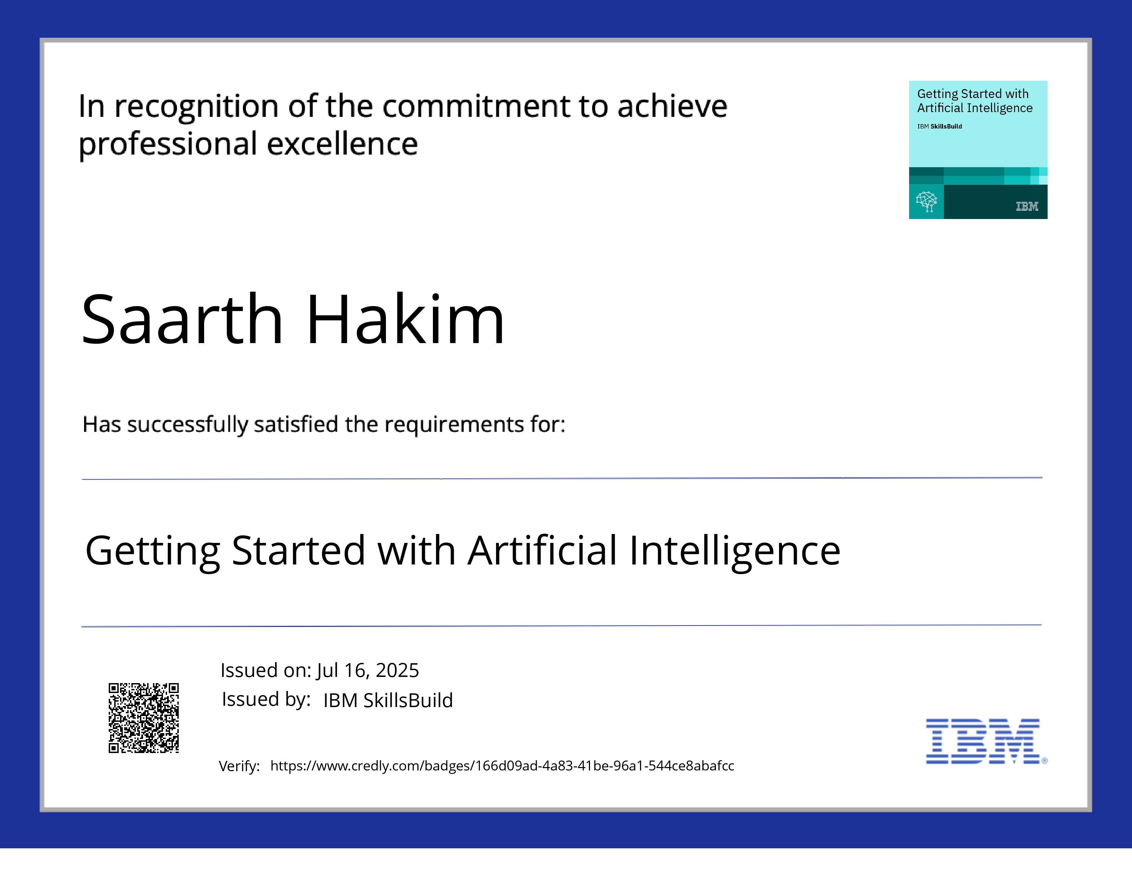
IBM Certifications

Slide 21
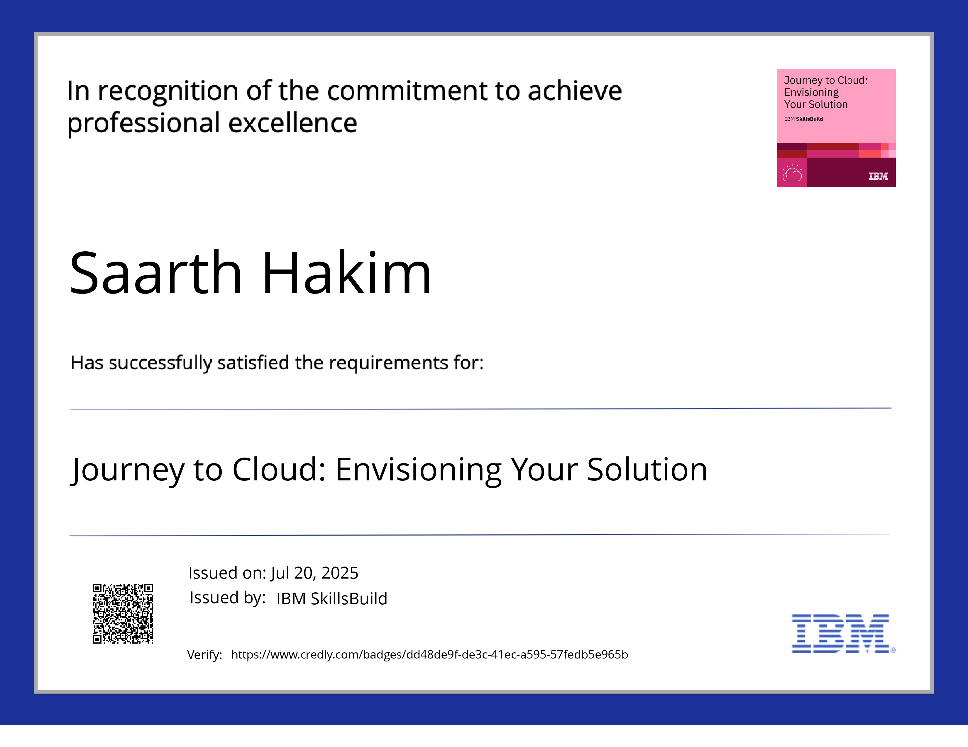
IBM Certifications

Slide 22
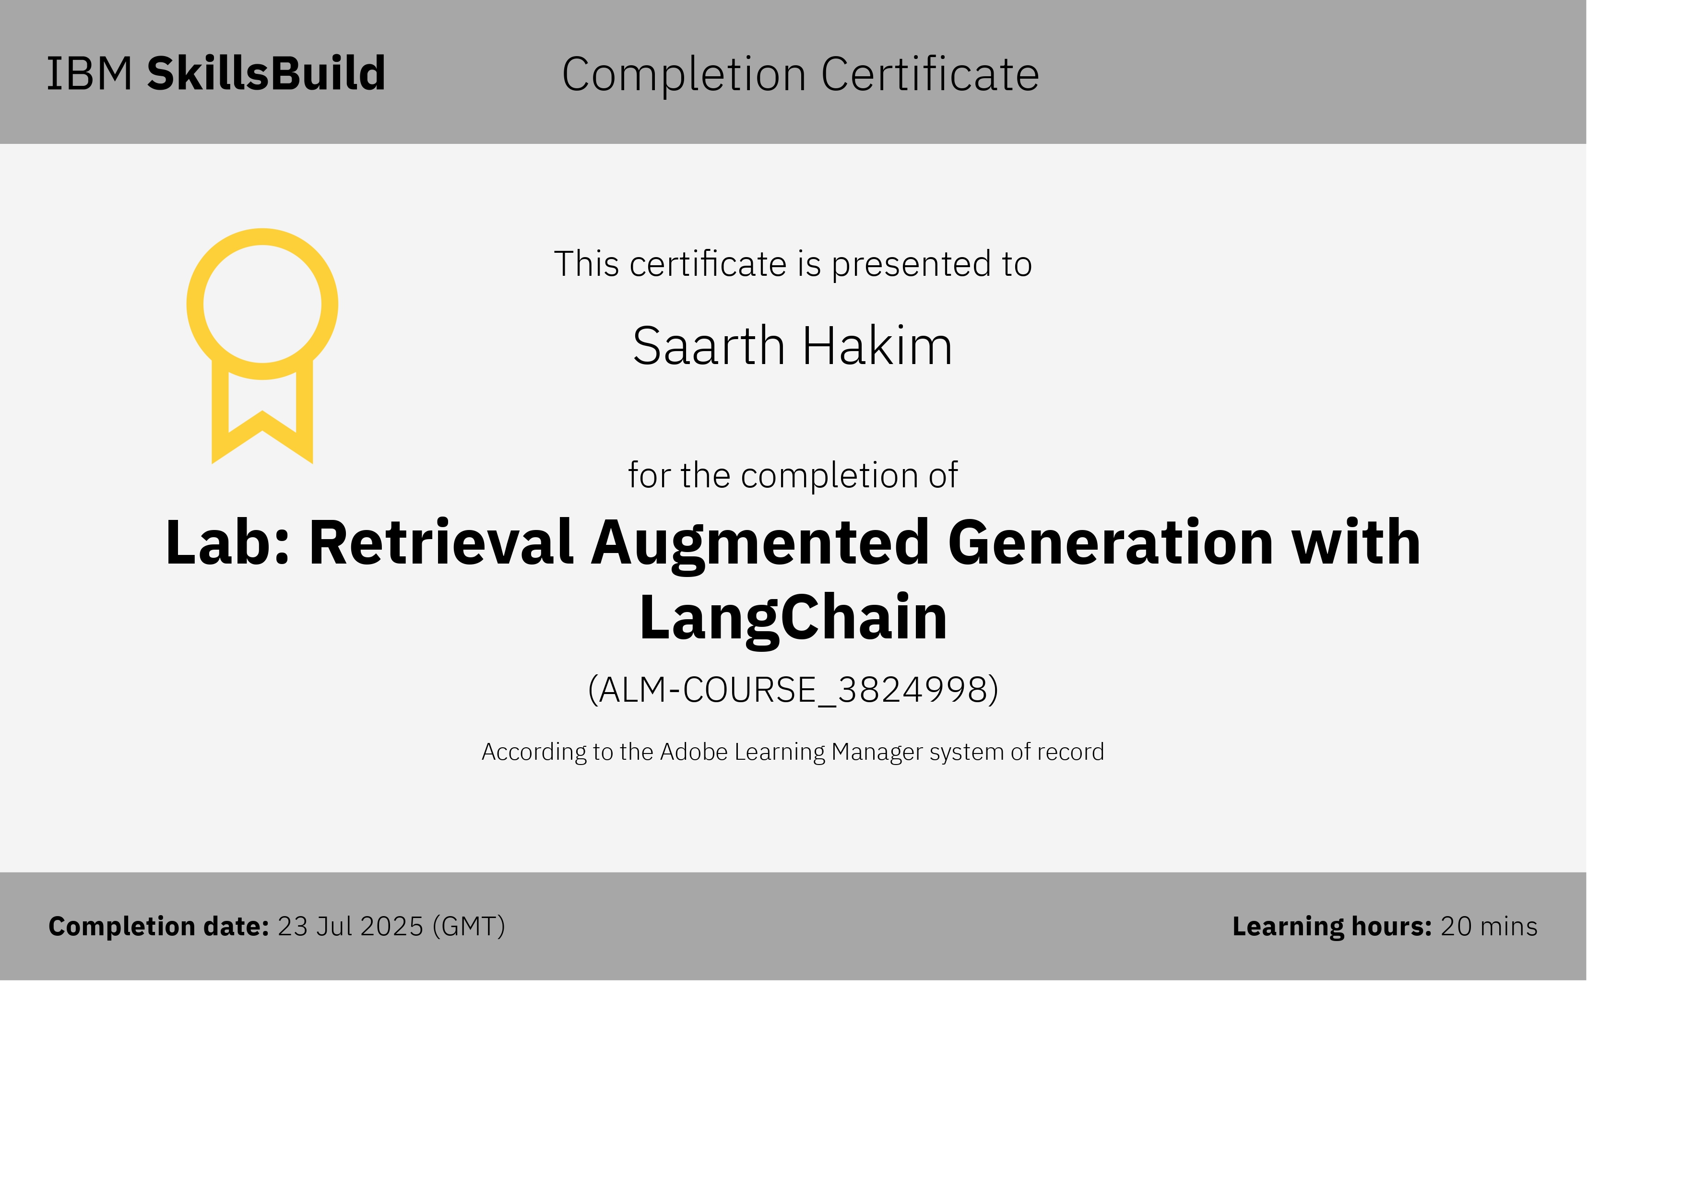
IBM Certifications

Slide 23
THANK YOU

